Slide 1
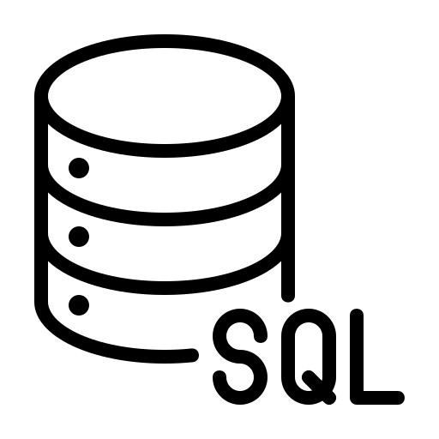

MongoDB vs SQL: A Comparison

Slide 2
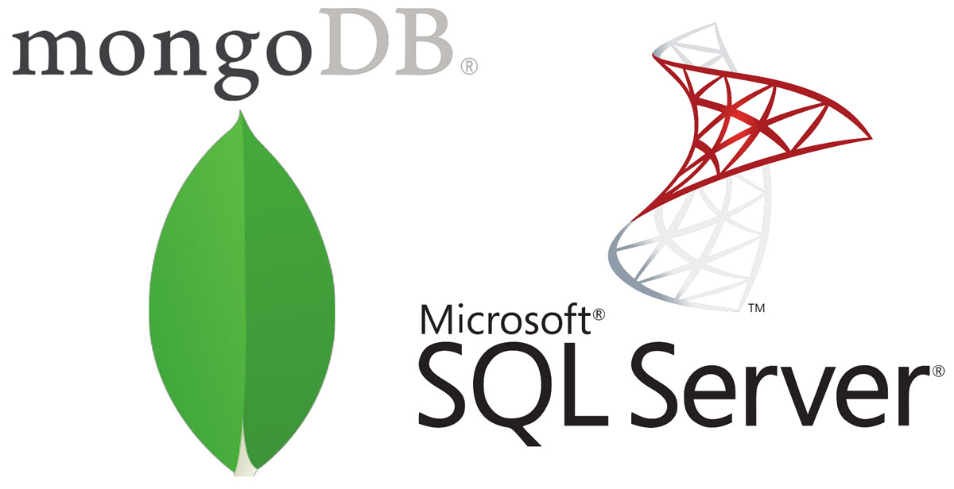
Introduction to MongoDB and SQL
MongoDB is a NoSQL database(stands for Not Only SQL) while SQL is a traditional Relational Database Management System (RDBMS).
MongoDB is document-based while SQL is table-based.
MongoDB stores data in BSON (Binary JSON) format while SQL stores data in tabular format.

Slide 3
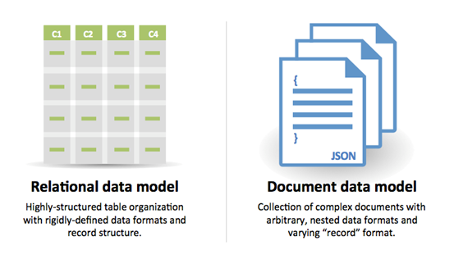
Data Model
MongoDB uses a flexible and dynamic schema with documents that can have varying fields and structures within a collection.
SQL uses a predefined and rigid schema with tables that have fixed columns and data types.

Slide 4
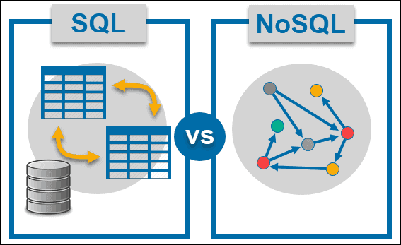
Query Language
MongoDB uses a rich query language that supports nested documents, regular expressions, and geospatial queries.
SQL uses a structured query language (SQL) that supports complex queries, joins, and aggregations.

Slide 5
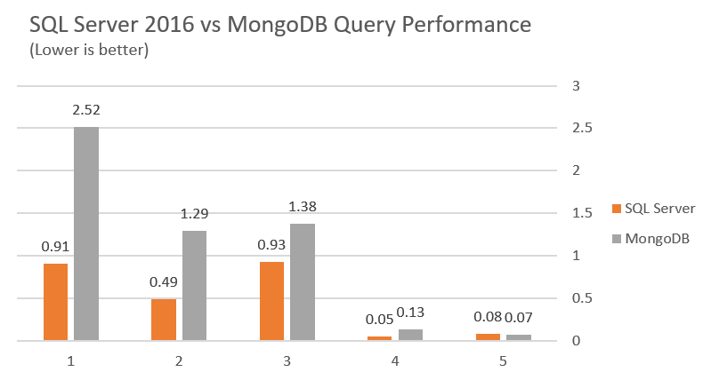
Scalability and Performance Model
MongoDB is horizontally scalable, which means it can distribute data across multiple servers to handle large datasets and high traffic.
SQL is vertically scalable, which means it can handle increasing workloads by adding more resources (CPU, RAM, etc.) to a single server.

Slide 6

Use Cases and security
MongoDB is suitable for applications that require high-speed reads and writes, flexible schema, and real-time analytics, such as social media, gaming, and IoT.
SQL is suitable for applications that require strict data consistency, transaction support, and complex queries, such as banking, e-commerce, and healthcare.
Both databases guarantee data protection by authenticating, authorizing, and using encryption whether it is in transit or not being used.

